Slide 1


SENTIMENT ANALYSIS ON CUSTOMER CHURN BEHAVIOUR
TEXT ANALYTICS
Group 12
Saloni Singh Yadav RBA26
Kanchan Ninawe RBA100
Ojaswi Soni RBA18
Ritika Rajoria RBA24
Pranav Khadke RBA108
Ritesh Shinde RBA 111

Slide 2
1
INTRODUCTION
Customer churn, the rate at which customers stop doing business with a company, is a critical metric for any business. High churn rates can have significant negative consequences, including:
Loss of revenue: Churned customers no longer generate revenue.
Increased acquisition costs: Businesses must spend more on acquiring new customers to replace those lost to churn.
Damage to brand reputation: Negative word-of-mouth from churned customers can harm a company's reputation.
Decreased customer lifetime value: Churn reduces the overall value that customers bring to a business

Slide 3
DATASET OVERVIEW
3
The dataset, named Telco_Churn, contains information related to customer churn in a telecom company. It consists of 33 columns, detailing various attributes of customers. Below is a description of the key fields:
1. CustomerID: Unique identifier for each customer.
2. Count: Numeric value (likely the number of accounts or interactions).
3. Country, State, City, Zip Code: Location-based information.
4. Latitude, Longitude: Geographic coordinates of customers.
5. Gender: Gender of the customer (Male/Female).
6. Contract: Type of contract the customer is on (e.g., Month-to-month).
7. Paperless Billing: Whether the customer has paperless billing.
8. Payment Method: Method used for payment (e.g., Electronic check, Bank transfer).
9. Monthly Charges: Monthly charges for the customer.
10. Total Charges: Total amount billed to the customer.
11. Churn Label: Whether the customer churned (Yes/No).
12. Churn Value: Binary representation of churn (1 for Yes, 0 for No).
13. Churn Score: A score representing the likelihood of churn.
14. CLTV: Customer Lifetime Value.
15. Churn Reason: Reason why the customer churned (e.g., Competitor made better offer).
The dataset provides rich details about each customer's demographics, billing, and churn behavior, which can be useful for churn analysis.

Slide 4
DATA PRE-PROCESSING
4
Importing Necessary Libraries
pandas
numpy
textblob
For data manipulation and analyse
For numerical operations, such as arrays and matrices.
For performing text processing tasks like sentiment analysis.
wordcloud
nltk.tokenize
nltk
To create word cloud visualizations.
For tokenizing text into words and sentences
Natural language processing library, with punkt being used for tokenization.

Slide 5
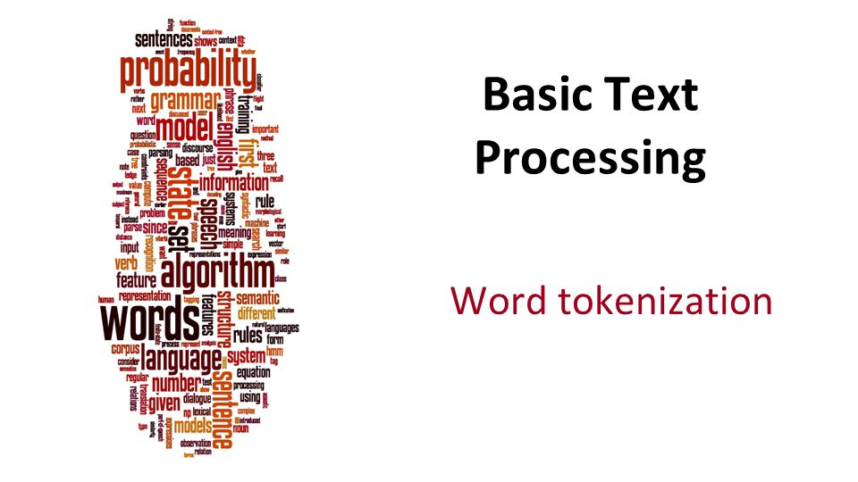
Loading Dataset and Initial Setup
Downloaded tokenizer data from nltk.
Loaded the dataset from an Excel file .
Displayed the column names to identify the structure of the dataset.
Checking the first few rows of the dataset for better understanding.
Column Identification for Text Processing
The code checks if columns like Churn Reason or Feedback exist to focus on customer churn explanations.
If these columns do not exist, a KeyError is raised.
Data Cleaning and Conversion
Missing values in the identified text column are removed using dropna. Ensures the text column data is converted into a string type for consistent processing.
Tokenization
Word Tokenization: Converts the text into individual words using word_tokenize.
Sentence Tokenization: Converts the text into sentences using sent_tokenize.
These tokenized outputs are stored in new columns for further analysis and visualization.

Slide 6
5
TEXT ANALYSIS TECHNIQUES
Technique | Contextual Awareness | Semantic Understanding | Best Use Cases
Bag of Words (BoW) | Low (no word order) | Limited | Keyword extraction, document classification
N-Gram Analysis | Medium (captures phrases) | Partial (short dependencies) | Text completion, phrase mining, more context than BoW
TF-IDF | Low | Moderate | Document relevance, search engine optimization (SEO)
Sentiment Analysis | High (emotional tone) | High (subject to training) | Opinion mining, customer feedback, brand monitoring

Slide 7
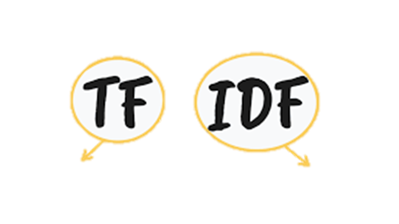

TF-IDF ANALYSIS
6
Statistical measure used to evaluate how important a word is to a document within a corpus
Term Frequency
Inverse Document Frequency
measures how important a word is by the IDF score.
Higher IDF score-the term is rare, appearing in fewer documents.
Lower IDF score-the term is common, appearing in many documents.
measures how frequently a term appears in a specific document

Slide 8
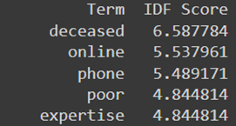
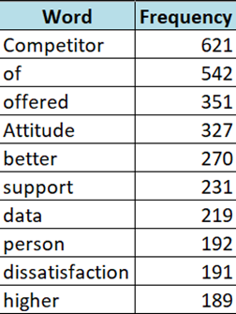
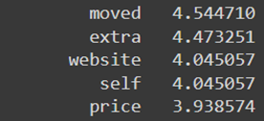
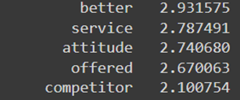
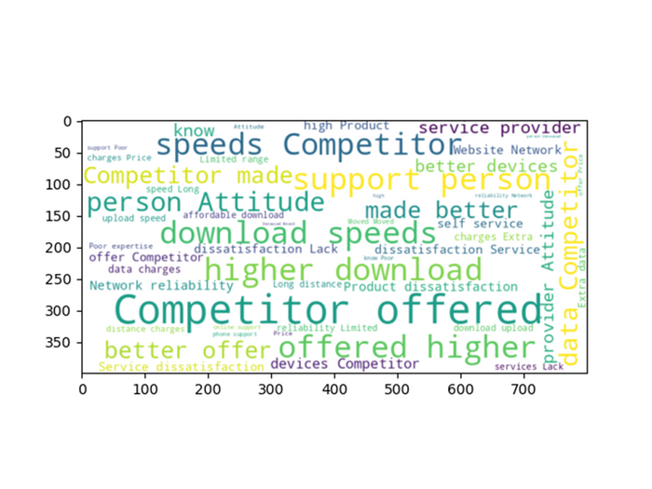
7
"Deceased" likely refers to rare, specific cases where the customer left due to death.
"Moved" indicates that several customers churned due to relocation, but it’s not the most frequent reason.
"Competitor" is mentioned often, indicating that many customers left because they found a better deal or service elsewhere.

Slide 9


SENTIMENT ANALYSIS POLARITY AND SUBJECTIVITY
8
Polarity: Measures if the sentiment is positive (above 0), negative (below 0), or neutral (0).
Subjectivity: Captures whether the statement is based on facts or personal opinions.
Correlation Matrix
Covariance Matrix

Slide 10
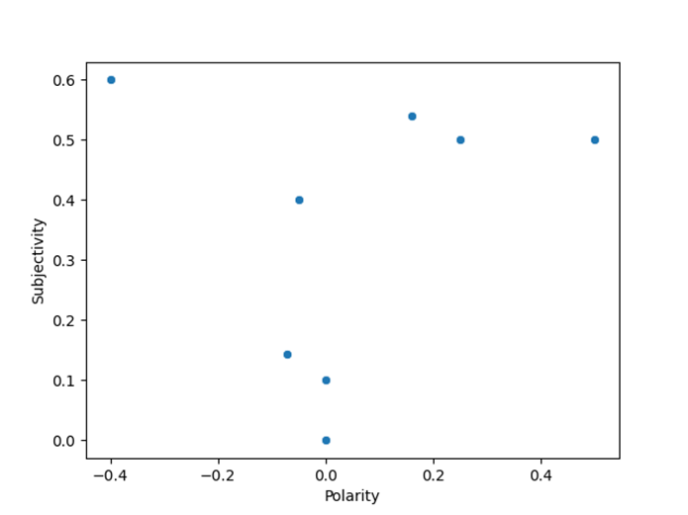
9
KEY INSIGHTS
1. Average Polarity: 0.14
Indicates general satisfaction with slight positivity in customer feedback.
Suggests room for improvement to enhance overall customer experiences.
2.Average Subjectivity: 0.22
Feedback is mostly objective and fact-based, reflecting real customer experiences.
Objective insights allow for data-driven decision-making to improve services.
3.Overall Sentiment: Neutral or Slightly Positive
Customers are generally content, but there’s potential to exceed expectations.
A stable customer base can be further engaged through service improvements.

Slide 11
10
RECOMMENDATIONS
1. Maintain Service Quality and Consistency
Focus on Core Strengths:
Ensure key strengths like reliability, product quality, and responsiveness are consistently delivered.
Monitor performance metrics (e.g., response times, product defects) to maintain high standards.
Implement Continuous Monitoring:
Regularly track customer satisfaction using feedback tools like NPS or CSAT.
Use this data to catch and resolve service dips before they become larger issues.
2. Proactively Address Potential Issues
Develop a Feedback Loop:
Create channels for customers to provide feedback easily (e.g., follow-up emails, website forms).
Automate feedback requests after important touchpoints, like purchases or service interactions.
Customer-Centric Solutions:
Address feedback by tailoring services to customer needs (e.g., improved response times or customized solutions).
Assign a team or individuals to analyze and prioritize addressing recurring customer concerns.

Slide 12
THANK YOU

